Slide 1
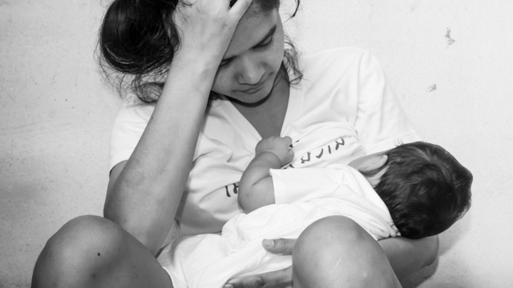
Teenage
Pregnancy Awareness

Slide 2
POINTERS
Title
Introduction
Purpose
Description
Support
Contact Information

Slide 3
Save your body, save your future.
Gerald Marquez
Angel Babes Rebayla
Crisabel Tania
John Lloyd Bangcaya

Slide 4
INTRODUCTION
Teenage pregnancies are associated with social issues, including lower educational levels and poverty.
For girls aged 15–19, risks are associated more with socioeconomic factors than with the biological effects of age. Risks of low birth weight, premature labor, anemia, and pre-eclampsia are connected to biological age,
We want to be part of the change—to help people be aware of the consequences of their actions. To help them pick wisely their priorities in life. To help them be a good daughter/son and parents in the future.

Slide 5
PURPOSE
Our main purposes are:
To control population.
To fight poverty and malnutrition.
To avoid health complications.
To avoid abortion.
To avoid death.
To promote family planning.
To give children a better future.
To the growth of our economy.

Slide 6
DESCRIPTION
The very best way to avoid teenage pregnancy is education.
We educate teens—like us—the consequences of getting pregnant in an early age.
Since we are in a pandemic, we will conduct online meetings in different social media platforms.
We will post different posters and any other visuals to remind people the abstinence.

Slide 7
SUPPORT
This project would need internet support, gadgets, equipment, and volunteers who are willing to make a poster or be a facilitator in any of our virtual meetings.

Slide 8
CONTACT INFORMATION
If you need help and for more inquiries contact any of us:
Gerald Marquez– 09493132137
Angel Rebayla – 09458016087
Crizabel Tania – 09514411823
John Lloyd Bangcaya – 09565619758

